Slide 1
Routing

Slide 2
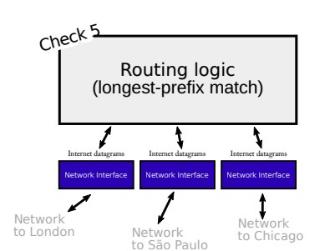
Previously:
Routing tables tell computers where to send packets to their intended destination
How do we build a routing table?

Slide 3
Exercise: Send Packets
Each person has two cards
1 has your router ID
Other note is your datagram (source: your router ID, some destination)
Each person should end up with their corresponding destination datagram
Can only pass notecards to your neighbors

Slide 4
General Approaches
Flooding: Send the packet across every link
Source Routing: source host controls the whole path
Distributed Algorithms: Each node makes a decision based on knowledge of the topology
Bellman-Ford
Dijkstra's
Notes:
Flooding similar to ARP
Flooding requires no routing table

Slide 5
Flooding
Pros:
Does not require a routing table
Naturally will arrive at the destination using the shortest path
Cons:
Inefficient
Possible Infinite Loops (need TTL)
Sending excess information

Slide 6
Source Routing
A
“Bird’s eye view” source router already knows the intended path
At each step, use information already provided to send to next hop
Cons:
Reveals the network topology
Larger overhead
C
B
[B]
E
F
D
[E, B]
[D, E, B]
Notes:
Let’s say you are a ISP, do to security and competition you don’t want to reveal the entire network

Slide 7
Distributed Routing Algorithms: Bellman Ford
Initialize distance for each node as infinity (and itself as 0)
Assume nodes know the cost for every directly connected node
After T seconds (ex: 30), send update to every neighboring node about current distance to each node
If newly advertised cost is less than what is currently in routing table, update
Go back to step 3
Notes:
“Vector of distances”

Slide 8
Example: Bellman Ford, Cost to F
A | B | C | D | E
∞ | ∞ | ∞ | ∞ | ∞
∞ | ∞ | ∞ | 2 | 4
∞ | 5, E | 9, E | 2 | 3, D
7, B | 4, E | 8, E | 2 | 3, D
6, B | 4, E | 8, E | 2 | 3, D
6, B | 4, E | 8, E | 2 | 3, D
A
3
2
C
B
5
1
E
4
1
F
D
2

Slide 9
Distributed Routing: Dijkstra's
Mark all nodes as unvisited, and set cost for current node as 0
Find current set of all unvisited neighbors from previously added nodes
Add the node to visited set that is the shortest known cost (will not have to check that node again)
Repeat from 2 until all nodes are visited
Notes:
Creates a minimum cost spanning tree

Slide 10
Example: Dijkstra’s, Best path from B to C
Shortest Paths | Candidates | Added
B | A, E | E
BE (1) | A, D, F, C | D
BED (2) | A, F, C | A
BED (2) BA (2) | F, C | F
BEDF (4) BA (2) | C | C
BEDF (4) BAC (5) | NONE | NONE
A
3
2
C
B
5
1
E
4
1
F
D
2
Notes:
Breaking Ties

Slide 11
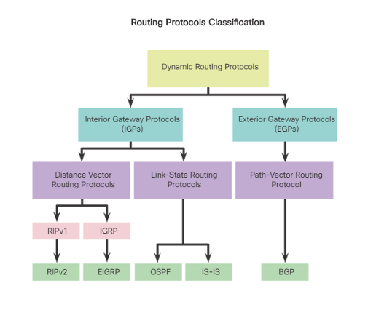
Routing Protocols
Distance Vector: sends their entire routing table to directly connected neighbors
Link State: Every router shares information about their neighbors, then independently calculate the best path to each destination
Path-Vector: contains the destination network, next router, and path to reach the destination
Notes:
RIP, OSPF, and BGP
Purpose and Operation
Rip “receives the information”
OSPF “observes” the network

Slide 12
RIP: Routing Information Protocol
Distance vector with hop count as the metric
Uses the Bellman Ford Algorithm
Continuously looks for updates, each node only knows about it’s neighbor

Slide 13
RIP
What happens when a link is cut?
R1
1
R2
1
R3
R1 | R2
2, R2 | 1, direct
Notes:
Distance to R3

Slide 14
RIP
What happens when a link is cut?
(RIP has a hop count limit of 15)
R1
R2
R3
R1 | R2
2, R2 | 1, direct
3, R2 | 2, R1
4, R2 | 3, R2
∞ | ∞
Notes:
We can say that R1 can’t ever give us a better path
Limit count

Slide 15
OSPF: Open Shortest Path First
Link state
Only updates when there is a change in the topology
Can use different metrics (link rate, congestion, etc)
Each router calculates Dijkstra's Algorithm independently
Each node has a full picture of the network
Notes:
Bandwidth as default
Better scalability
“Tell the world about its neighbors”

Slide 16
RIP vs OSPF
RIP | OSPF
Bellman Ford Can be slow to converge Gets updates from neighbors Uses hop count as a metric Continuously sends updates Fully distributed Better in smaller networks | Dijkstra’s Faster Converge Requires knowledge of full topology Uses link rate as a metric Updates only on topology changes Calculates shortest path independently Can be used in large networks
Notes:
Hop count limit for RIP

